Slide 1
Should we change how we position biologics in ulcerative colitis?
Bruce E. Sands, MD, MS
Chief of the Dr. Henry D. Janowitz Division of Gastroenterology
Dr. Burrill B. Crohn Professor of Medicine
Icahn School of Medicine at Mount Sinai
New York, NY

Slide 2
Disclosures
AbbVie
Amgen
Avaxia Biologics
Bristol-Myers Squibb
Janssen Biotech
Pfizer
Prometheus Laboratories
Puretech Ventures, LLC
Millennium Pharmaceuticals/Takeda

Slide 3
Learning Objectives
To understand the efficacy and safety of infliximab, adalimumab and golimumab, anti-TNF antibodies approved for the treatment of ulcerative colitis
To understand the efficacy and safety of vedolizumab, an anti-α₄β₇ integrin antibody newly approved for the treatment of ulcerative colitis
To identify factors to consider in positioning biologics in treating ulcerative colitis

Slide 4
Sequential Therapies for Ulcerative Colitis
Adalimumab 9/28/2012
Golimumab 5/15/2013
Vedolizumab 5/20/2014
?
Disease Severity
at Presentation
Colectomy
Infliximab
Cyclosporine
Infliximab
Thiopurine
Severe
Moderate
Mild
Aminosalicylate
Thiopurine
Corticosteroid
Aminosalicylate
Aminosalicylate
Induction
Maintenance
Therapy is stepped up according to severity at presentation or failure at prior step

Slide 5
Considerations for positioning biologic therapy
Disease severity
Extent of disease
Prior and current therapies
Safety
Cost
Kornbluth A, Sachar DB, et al. Am J Gastroenterol 2010; 105:501–523

Slide 6
A Lexicon of Biologics Studies in UC
Infliximab
ACT 1 & 2
CYCIF
Adalimumab
ULTRA 1 & 2
Golimumab
PURSUIT
Vedolizumab
GEMINI 1

Slide 7
Infliximab for Moderate to Severe Ulcerative Colitis: ACT 1 & 2
Clinical Response at Week 8
P<0.001
P<0.001
P<0.001
P<0.001
Clinical Remission at Week 8
P=0.002
P<0.001
P<0.001
P<0.001
Placebo
Infliximab 5 mg/kg
Infliximab 10 mg/kg
Rutgeerts P, et al. N Engl J Med. 2005;353:2462-79.

Slide 8
Infliximab for severe UC in the hospital setting
 |  |  |  | Response Rate
Study | N | Infliximab Dose | Outcome Measure | Infliximab | Placebo | Steroid
Sands 2001¹ | 11 | 5, 10, 20 mg/kg x 1 | ↓Lichtiger Score ≥5 to <10 at 2 weeks | 50% | 0% | ---
Armuzzi 2004² | 20 | 5 mg/kg x 3 | Sutherland score ≤2 at 2 weeks | 100% | --- | 100%
Ochsenkühn 2004³ | 13 | 5 mg/kg x 3 | ↓Lichtiger Score ≥5 to <10 at 3 and 13 weeks | 83% | --- | 86%
Järnerot 2005⁴ | 45 | 5 mg/kg x 1 | No colectomy at 90 days | 67% | 29% | ---
¹Sands B, et al. Inflamm Bowel Dis 2001;7:83.
²Armuzzi et al. Eur Rev Med Pharmacol Sci 2004;8:231.
³Ochsenkuhn et al. Eur J Gastroenterol Hepatol 2004;16:1167.
⁴Järnerot G, et al. Gastroenterology 2005;128:1805

Slide 9
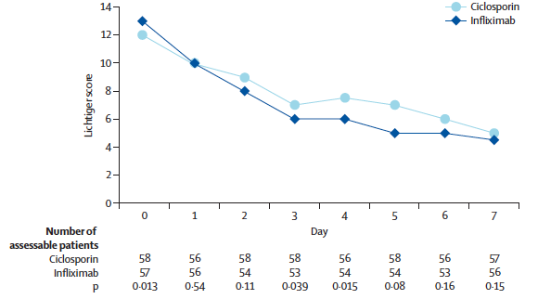
CYCIF: Cyclosporine vs. Infliximab in Severe, Steroid-Refractory UC
Laharie D, et al. Lancet 2012; 380: 1909–15

Slide 10
Adalimumab in UC: ULTRA2 Baseline Characteristics
 | Placebo (n=246) | Adalimumab (n=245 | Total (n=494)
Disease Location
Pan-ulcerative colitis | 48.8% | 48.4% | 48.6%
Descending | 39.0% | 38.7% | 38.9%
Other | 12.2% | 12.9% | 12.9%
CRP above ULN (4.94 mg/L) | 47.2% | 45.7% | 46.5%
Mayo Score, mean | 8.9 | 8.9 | 8.9
Concomitant Med
Corticosteroid | 56.9% | 60.5% | 58.7%
6MP/AZA | 32.5% | 37.5% | 35.0%
6MP/AZA + CS | 18.3% | 20.2% | 19.2%
Prior Anti-TNF | 41.1% | 39.1% | 40.3%
Sandborn WJ et al. Gastroenterology. 2012;142:257-265.

Slide 11
Adalimumab in UC: ULTRA 2 Week 8 and 52 Results
Week 8
Week 52
Week 8 and 52
P<.001
P =.03
P<.01
P<.01
P<.001
P<.01
Patients (%)
P =.02
P =.004
P<.05
MH = Mucosal Healing
Sandborn WJ et al. Gastroenterology. 2012;142:257-265.

Slide 12
Adalimumab in UC: ULTRA 2 Results By Prior Infliximab Exposure
P=.019
P=.038
Sandborn WJ et al. Gastroenterology. 2014;142:257-265.

Slide 13
Adalimumab in UC: ULTRA 2 Discontinuation of Corticosteroids
45
Placebo
40
Adalimumab
*
*
35
*
*
30
*
Patients who discontinue corticosteroids (%)
25
20
15
10
5
0
8
12
16
20
26
32
38
44
52
Week
*P < 0.05
Sandborn WJ. Gastroenterology 2012;142:257-65.

Slide 14
Adalimumab in UC: ULTRA2 Subgroup Analyses
Odds ratios favor adalimumab for clinical remission at week 8 and week 52 regardless of
Weight
Prior anti-TNF use
Baseline CRP
Baseline Mayo Score
Disease extent
Disease duration
Endoscopy score
Sandborn WJ. Gastroenterology 2012;142:257-65.

Slide 15
PURSUIT: Golimumab for the Induction of Moderate to Severe UC
*
§
*P<.0001 vs placebo
§P=0.0014 vs. placebo
Sandborn WJ, et al. Gastroenterology. 2014;146:85–95.

Slide 16
PURSUIT: Golimumab for the Maintenance of Moderate to Severe UC
*
*P=0.01 vs placebo
§P<0.001 vs. placebo
⌘P=0.004 vs. placebo
Sandborn WJ, et al. Gastroenterology. 2014;146:96–109.

Slide 17
PURSUIT: Corticosteroid-Free Remission at Wk 54 with Golimumab in UC
P=.423
P=.279
Proportion of patients* (%)
*Among those patients who were initially receiving corticosteroids.
Sandborn WJ, et al. Gastroenterology. 2014;146:96–109

Slide 18
Infections and Mortality in the TREAT Registry: 15,000 Patient-Years of Experience
Mortality
Serious infections
Steroids
AZA 6-MP MTX
Steroids
AZA 6-MP MTX
IFX
IFX
P<.001
P=.006
P=.002
AZA = azathioprine; IFX = infliximab; MTX = methotrexate.
Lichtenstein GR et al. Am J Gastroenterol. 2012;107:1409-1422.

Slide 19
Safety Issues With Anti-TNF Therapy
Infection and malignancy
Black-box warning for serious infection and malignancy for all anti-TNF therapies¹⁻³
Black-box warning for HSTCL (adalimumab and infliximab)^{1,2}
Reactivation of hepatitis B⁴, tuberculosis
Skin cancer⁴
Psoriasis⁴
Autoimmunity (lupus-like syndrome)⁴
Immunogenicity – antibodies to anti-TNF⁴
Demyelinating disorders, CHF, liver toxicity⁴
CHF=congestive heart failure; HSTCL= hepatosplenic T-cell lymphoma.
¹Remicade [package insert]. Horsham, PA: Janssen Biotech, Inc; 2013; ²Humira [package insert]. North Chicago, IL: AbbVie, Inc; 2013;
³Simponi [package insert]. Horsham, PA: Janssen Biotech, Inc; 2013;⁴Bongartz T, et al. JAMA. 2006;295:2275-2285.

Slide 20
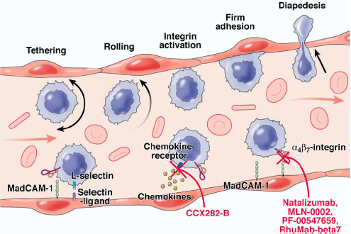
Leukocyte Trafficking as a Target in Inflammatory Bowel Disease
Vedolizumab
Rutgeerts P. Gastroenterology 2009;136:1182–1197

Slide 21
Specifically targeting the α4β7 integrin exerts gut-selective effects

Slide 22
Vedolizumab in UC: GEMINI 1 Baseline Characteristics
 | Placebo (n=149) | Vedolizumab (n=746) | Total (n=895)
Disease Location
Pan-ulcerative colitis | 33.6% | 37.9% | 37.0%
Prox to Splenic Flex | 12.1% | 12.2% | 12.2%
Descending | 39.6% | 37.5% | 37.9%
Rectum & Sigmoid | 14.8% | 12.6% | 13.0%
Mayo Score, mean | 8.6 | 8.6 | 8.6
Concomitant Med
Corticosteroid | 38.9% | 36.7% | 37.1%
6MP/AZA | 12.1% | 18.9% | 17.8%
6MP/AZA + CS | 17.4% | 16.5% | 16.6%
Prior Anti-TNF | 49.0% | 48.0% | 48.2%
Feagan BG. N Engl J Med 2013;369:699-710.

Slide 23
GEMINI I:Vedolizumab in UC Efficacy at week 6
Patients (%)
P<0.0001
P=0.0012
P=0.0009
95% CI:
21.7
11.6, 31.7
11.5
4.7, 18.3
16.1
6.4, 25.9
Feagan et al, N Engl J Med 2013;369:699-710

Slide 24
GEMINI I: Vedolizumab in UC Primary and secondary outcomes through 52 Weeks, maintenance ITT population
***
***
***
***
***
***
***
*
%
**
**
n:
72
70
73
Δ26.1 Δ29.1
Δ32.8 Δ28.5
Δ32.0 Δ36.3
Δ11.8 Δ15.3
Δ17.6 Δ31.4
*P<0.05 **P<0.01 ***P<0.0001
Feagan et al, N Engl J Med 2013;369:699-710

Slide 25
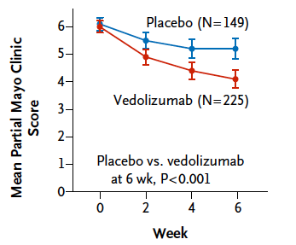
Vedolizumab in UC: Mean Partial Mayo Score through Week 6
Feagan BG. N Engl J Med 2013;369:699-710.

Slide 26
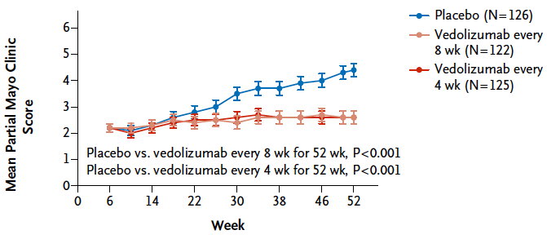
Vedolizumab in UC: Mean Partial Mayo Score from Week 6 to 52
Feagan BG. N Engl J Med 2013;369:699-710.

Slide 27
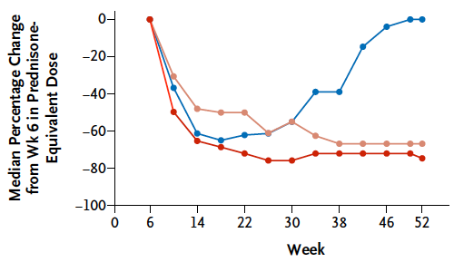
Vedolizumab in UC: % Change from Wk 6 in Prednisone-Equivalent Dose
Feagan BG. N Engl J Med 2013;369:699-710.

Slide 28
GEMINI I – Vedolizumab for the Treatment of UC (Induction) and Prior Anti-TNF Use
Prior Anti-TNF
Exposure
No Prior Anti-TNF
Exposure
Placebo
Vedolizumab
*P< 0.005
Feagan B, et al. Presented at DDW; May 22, 2012. Abstract 943b.

Slide 29
Vedolizumab in UC: GEMINI 1 Subgroup Analyses
Odds ratios favor vedolizumab for clinical response/remission at week 6 and week 52 regardless of
Age
Disease duration
Prior anti-TNF, corticosteroid, immunomodulator use
Baseline fecal calprotectin
Baseline Mayo Score
Disease extent
Feagan BG. N Engl J Med 2013;369:699-710.

Slide 30
Vedolizumab: Safety
Infusion-related Reactions
Immunogenicity
4 % (vs. 3% placebo)
<1% “severe”
<1% required discontinued therapy
Anaphylaxis:
1 / 1434 (0.07%)
4% anti-vedolizumab antibodies at any time during 52 weeks of study
16% persistently “+”
59% neutralizing
PML*
Tuberculosis
No cases
GEMINI 1 - 895 pts: 0 cases
GEMINI 2 - 1115 pts: 1 pt
*Progressive multifocal leukoencephalopathy
Entyvio [package insert]. Deerfield, IL: Takeda Pharmaceuticals America, Inc; May 2014.

Slide 31
Dosing biologic agents for UC
Infliximab
5 mg/kg IV weeks 0, 2, 6, and every 8 weeks
Adalimumab
160 mg, 80 mg, 40 mg SC every 2 weeks
Golimumab
200 mg SC wk 0, 100 mg SC wk 2, 100 mg SC wk 6, 100 mg SC every 4 weeks
Vedolizumab
300 mg IV weeks 0, 2, 6 and every 8 weeks

Slide 32
Positioning Biologics in UC
 | Anti-TNF Ab | Vedo
Induction
Early
Late
Maintenance
Standard therapy failure
Steroids
Immune modulators
Anti-TNF failure
Primary
Secondary
Severe, hospitalized | (IFX)
Safety Issues | Infection, Lymphoma, Immune Phenomena | Nasopharyngitis, ?PML

